Slide 1
Security Networks
Corporate Computer Security, 4th Edition
Randall J. Boyle & Raymond R. Panko
Chapter 4

Slide 2
Learning Objectives
Describe the goals of creating secure networks.
Explain how denial-of-service (DoS) attacks work.
Explain how ARP poisoning works.
Know why access controls are important for networks.
Explain how to secure Ethernet networks.
Describe wireless (WLAN) security standards.
Describe potential attacks against wireless networks.

Slide 3
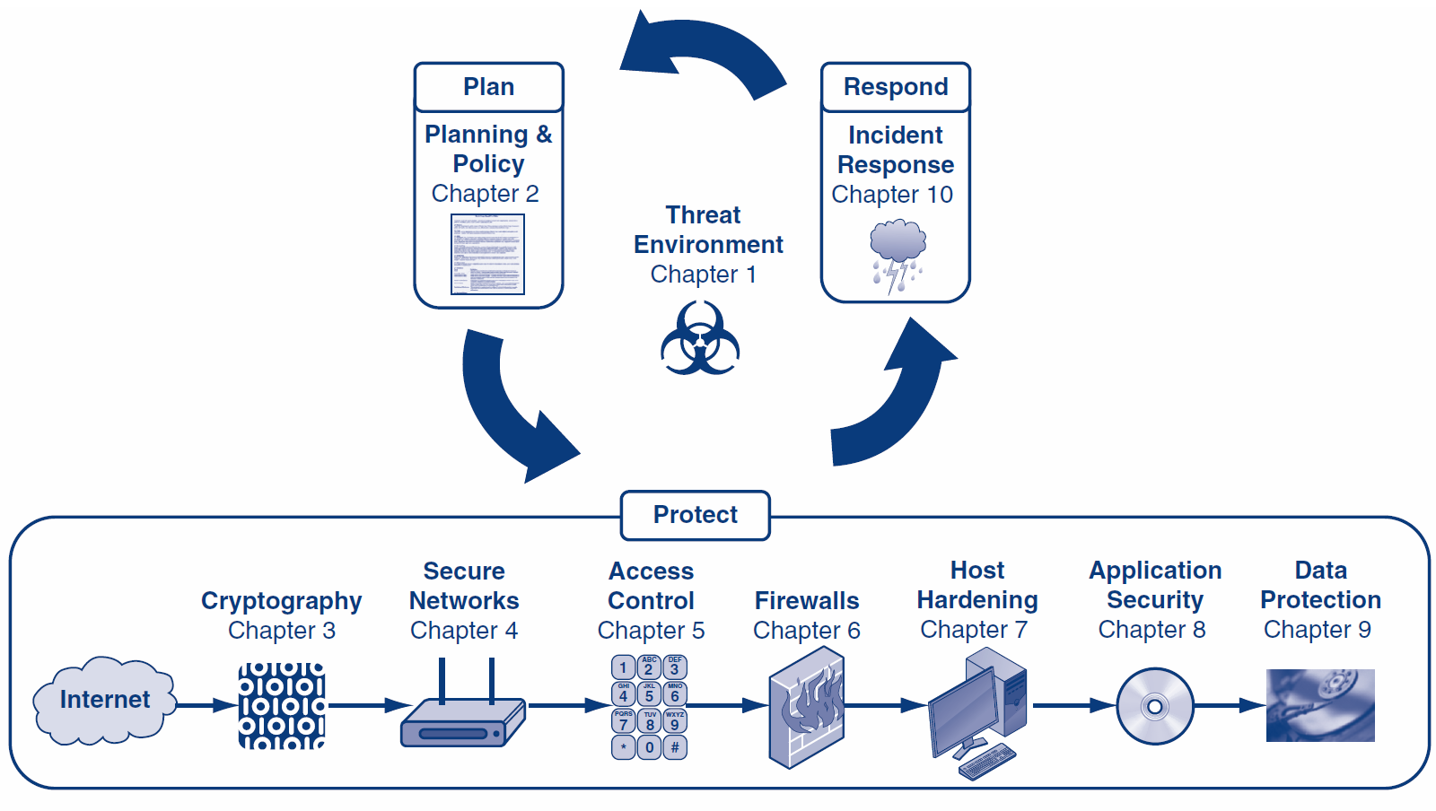

Slide 4
Orientation
Chapter 3 looked at how cryptography can protect data being sent across networks
Chapter 4 looks at how networks themselves are attacked
We will look at how attackers can gain unauthorized access to networks
We will also look at how attackers can alter the normal operation of a network
We will look at both wired (LAN) and wireless (WLAN) networks

Slide 5
What’s Next?
4.1 Introduction
4.2 Denial-of-Service (DoS) Attacks
4.3 ARP Poisoning
4.4 Access Control for Networks
4.5 Ethernet Security
4.6 Wireless Security

Slide 6
4.1: Threats to Secure Networks
Cryptography provides confidentiality, authenticity, and message integrity
Modern Networks have additional vulnerabilities
The means of delivering the messages could be stopped, slowed, or altered
The route the messages took could be altered
Messages could be redirected to false recipients
Attackers could gain access to communication channels that were previously considered closed and confidential

Slide 7
4.1: Creating Secure Networks
Goals of Creating Secure Networks
Availability—users have access to information services and network resources
Confidentiality—prevent unauthorized users from gaining information about the network
Functionality—preventing attackers from altering the capabilities or normal operation of the network
Access control—keep attackers or unauthorized employees from accessing internal resources

Slide 8
4.1: Death of the Perimeter
The “castle” model
Good guys on the inside, attackers on the outside, and a well-guarded point of entry
Death of the Perimeter
It is impractical, if not impossible, to force all information in an organization through a single point in the network
New means of attacking networks (e.g., smart phones) are constantly emerging
Line between “good guys” and “bad guys” has become blurred

Slide 9
4.1: Death of the Perimeter
The “city” model
No distinct perimeter, and there are multiple ways of entering the network
Like a real city, who you are will determine which buildings you will be able to access
Greater need for:
Internal intrusion detection
Virtual LANs
Central authentication servers
Encrypted internal traffic

Slide 10
What’s Next?
4.1 Introduction
4.2 Denial-of-Service (DoS) Attacks
4.3 ARP Poisoning
4.4 Access Control for Networks
4.5 Ethernet Security
4.6 Wireless Security

Slide 11
4.2: Denial of Service (DoS) Attacks
What is a DoS attack?
An attempt to make a server or network unavailable to legitimate users by flooding it with attack packets
What is NOT a DoS attack?
Faulty coding that causes a system to fail
Referrals from large websites that overwhelm smaller websites

Slide 12
4.2: Goals of DoS Attacks
Ultimate goal of DoS attacks is to cause harm
Harm includes: losses related to online sales, industry reputation, employee productivity, customer loyalty, etc.
The two primary means of causing harm via DoS attacks include:
Stopping critical services
Slowly degrading services

Slide 13
4.2: Methods of DoS Attacks
Direct DoS Attack
An attacker tries to flood a victim with a stream of packets directly from the attacker’s computer
Indirect DoS Attack
The attacker’s IP address is spoofed (i.e., faked) and the attack appears to come from another computer

Slide 14
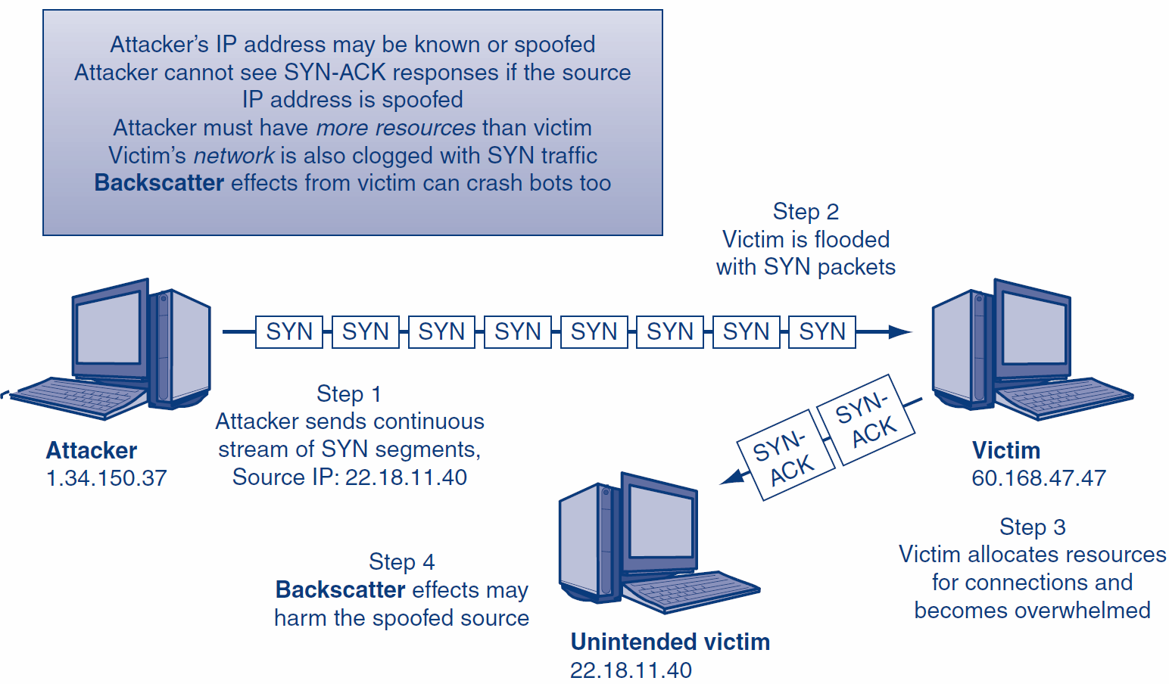
4.2: SYN Flood DoS Attack

Slide 15
4.2: Intermediaries (Bots)
Bots
Updatable attack programs
Botmaster can update the software to change the type of attack the bot can perform
May sell or lease the botnet to other criminals
Botmaster can update the bot to fix bugs
Botmaster can control bots via a handler
Handlers are an additional layer of compromised hosts who are used to manage large groups of bots

Slide 16
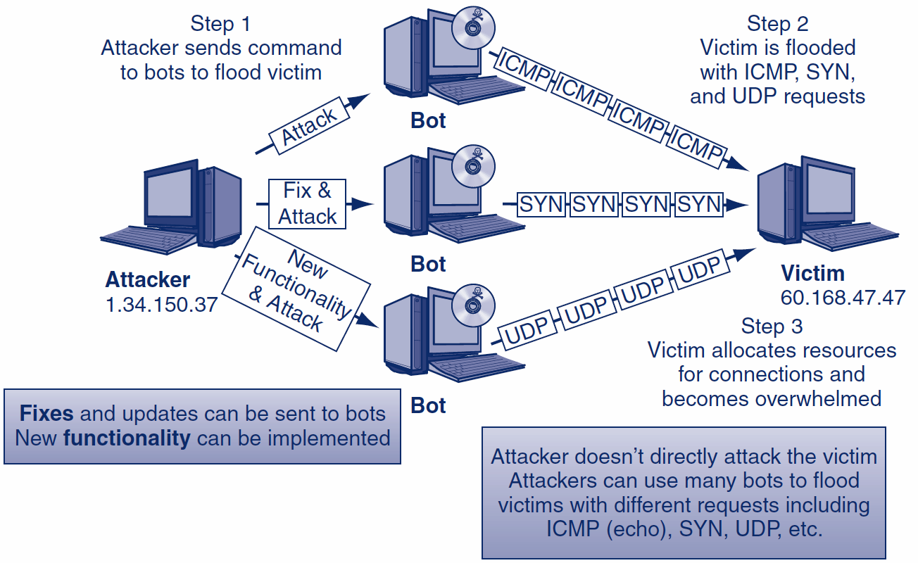
4.2: Fixing and Updating Bots

Slide 17
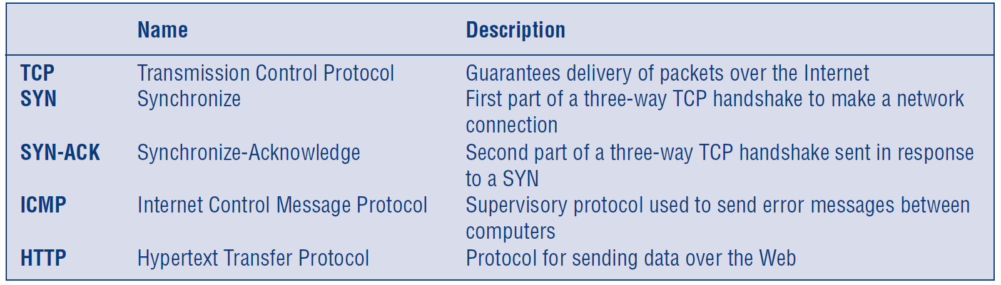
4.2: Types of DoS Packets Sent
Types of packets sent:

Slide 18
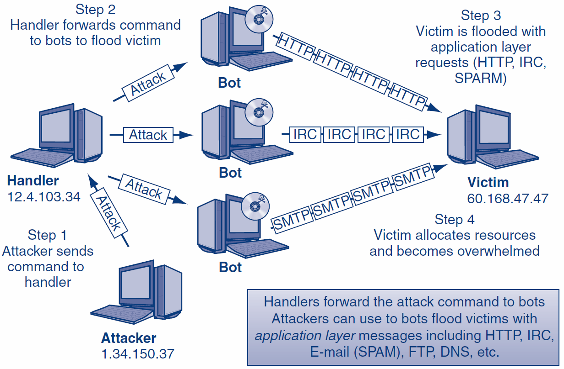
4.2: DDoS Attack

Slide 19
4.2: P2P DoS Attacks
Peer-to-peer (P2P) redirect DoS attack
Uses many hosts to overwhelm a victim using normal P2P traffic
Attacker doesn’t have to control the hosts, just redirect their legitimate P2P traffic

Slide 20
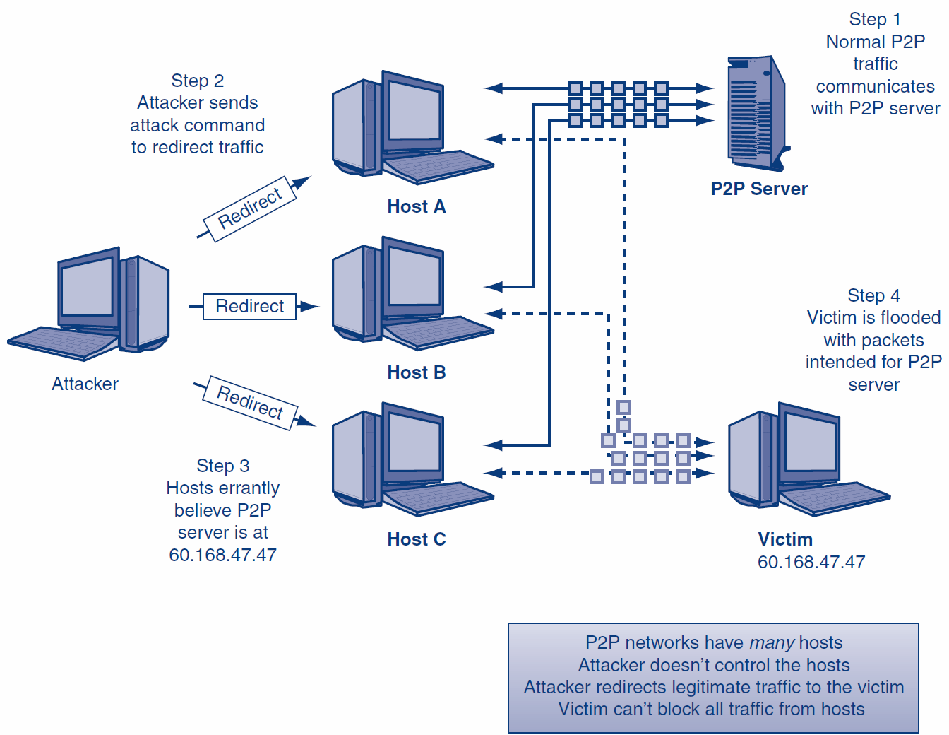
4.2: Peer-to-Peer Redirect Attack

Slide 21
4.2: Reflected DoS Attacks
Reflected DoS attack
Responses from legitimate services flood a victim
The attacker sends spoofed requests to existing legitimate servers (Step 1)
Servers then send all responses to the victim (Step 2)
There is no redirection of traffic

Slide 22
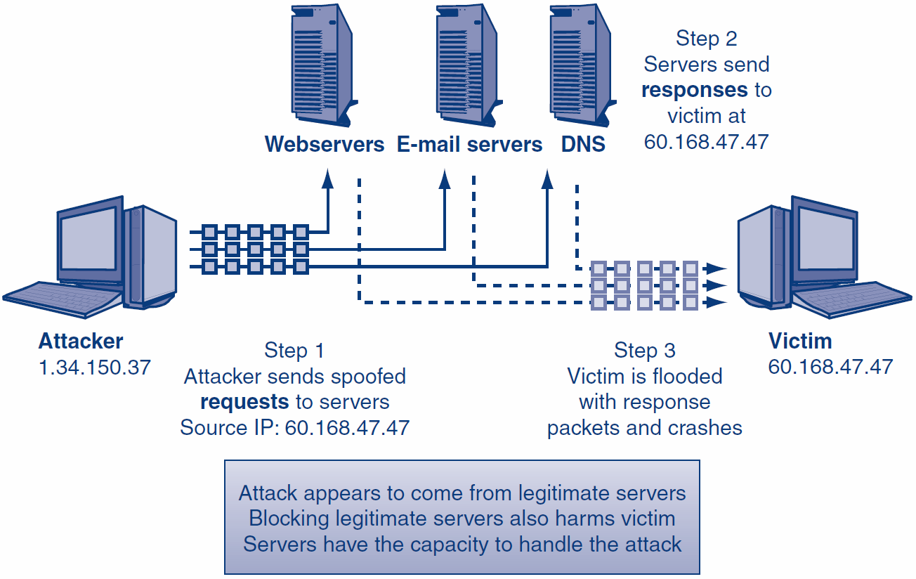
4.2: Reflected DRDoS Attack

Slide 23
4.2: Reflected DoS Attacks
Smurf Flood
The attacker sends a spoofed ICMP echo request to an incorrectly configured network device (router)
Broadcasting enabled to all internal hosts
The network device forwards the echo request to all internal hosts (multiplier effect)

Slide 24
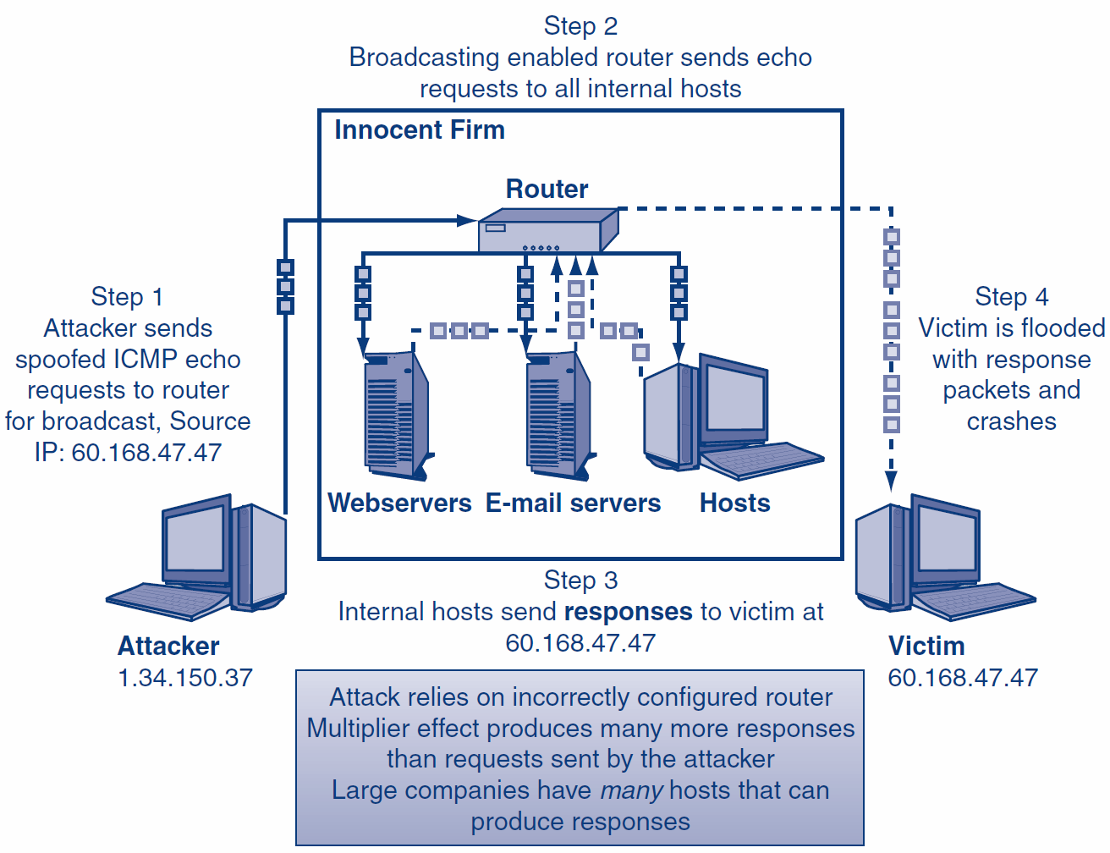
4.2: Smurf Flood

Slide 25
4.2: Defending Against DoS Attacks
Black holing
Drop all IP packets from an attacker
Not a good long-term strategy because attackers can quickly change source IP addresses
An attacker may knowingly try to get a trusted corporate partner black holed

Slide 26
4.2: Defending Against DoS Attacks
Validating the handshake
Whenever a SYN segment arrives, the firewall itself sends back a SYN/ACK segment, without passing the SYN segment on to the target server (false opening)
When the firewall gets a legitimate ACK back, the firewall sends the original SYN segment on to the intended server
Rate limiting
Used to reduce a certain type of traffic to a reasonable amount
Can frustrate attackers and legitimate users

Slide 27
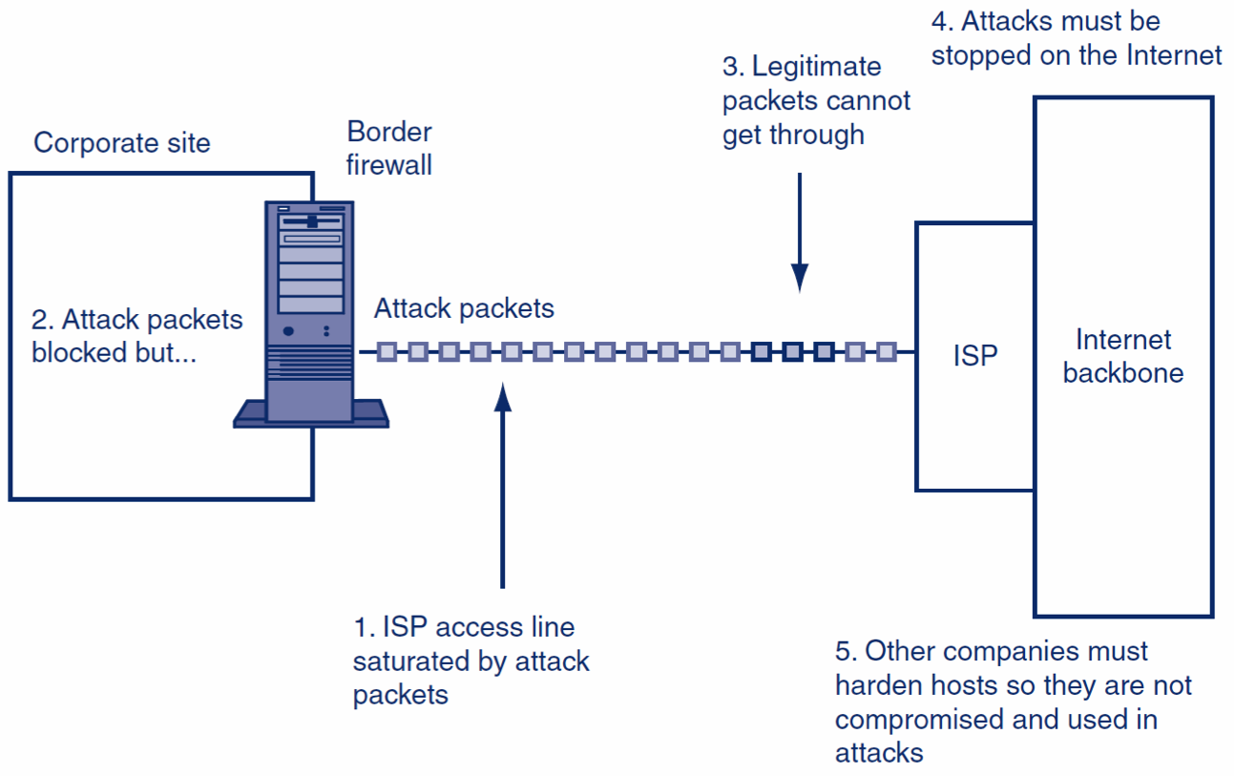
4.2: Stopping DoS Attacks

Slide 28
What’s Next?
4.1 Introduction
4.2 Denial-of-Service (DoS) Attacks
4.3 ARP Poisoning
4.4 Access Control for Networks
4.5 Ethernet Security
4.6 Wireless Security

Slide 29
4.3: ARP Poisoning
ARP Poisoning
Network attack that manipulates host ARP tables to reroute local-area network (LAN) traffic
Possible man-in-the-middle attack
Requires an attacker to have a computer on the local network
An attack on both the functionality and confidentiality of a network

Slide 30
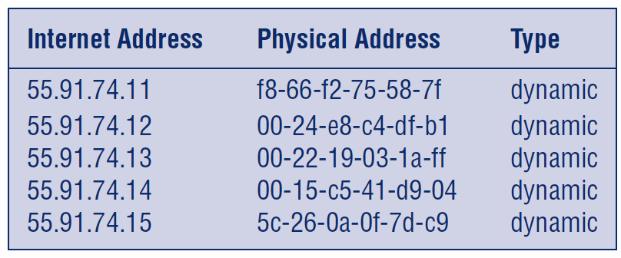
4.3: ARP Poisoning
Address Resolution Protocol (ARP)
Used to resolve 32-bit IP addresses (e.g., 55.91.56.21) into 48-bit local MAC addresses (e.g., 01-1C-23-0E-1D-41)
ARP tables store resolved addresses (below)

Slide 31
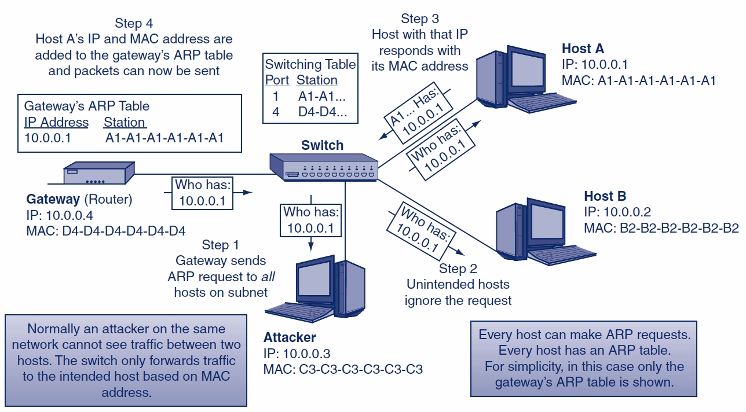
4.3: Normal ARP Operation

Slide 32
4.3: ARP Poisoning
The problem: ARP requests and replies do NOT require authentication or verification
All hosts trust all ARP replies
ARP spoofing uses false ARP replies to map any IP address to any MAC address
An attacker can manipulate ARP tables on all LAN hosts
The attacker must send a continuous stream of unsolicited ARP replies

Slide 33
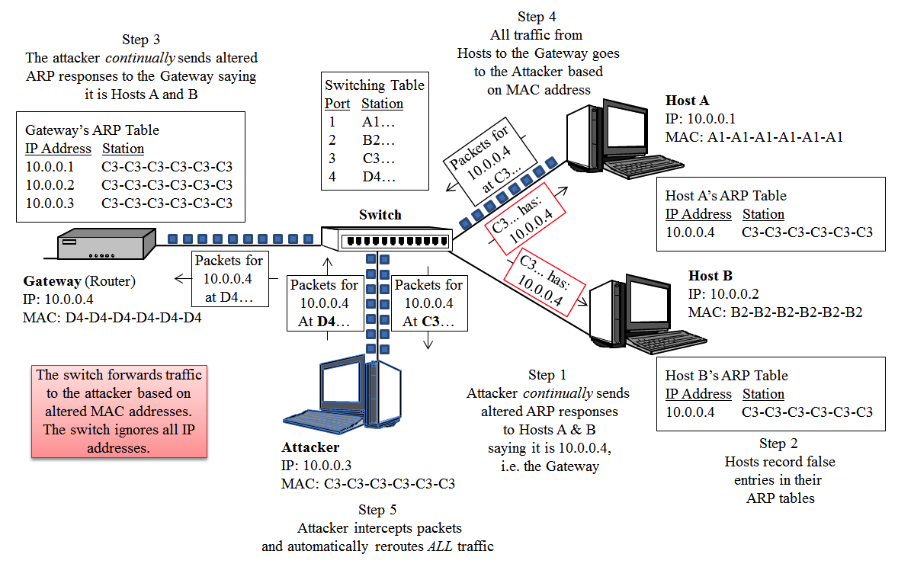
4.3: ARP Poisoning

Slide 34
4.3: ARP Poisoning
ARP DoS Attack
Attacker sends all internal hosts a continuous stream of unsolicited spoofed ARP replies saying the gateway (10.0.0.4) is at E5-E5-E5-E5-E5-E5 (Step 1)
Hosts record the gateway’s IP address and nonexistent MAC address (Step 2)
The switch receives packets from internal hosts addressed to E5-E5-E5-E5-E5-E5 but cannot deliver them because the host does not exist
Packets addressed to E5-E5-E5-E5-E5-E5 are dropped

Slide 35
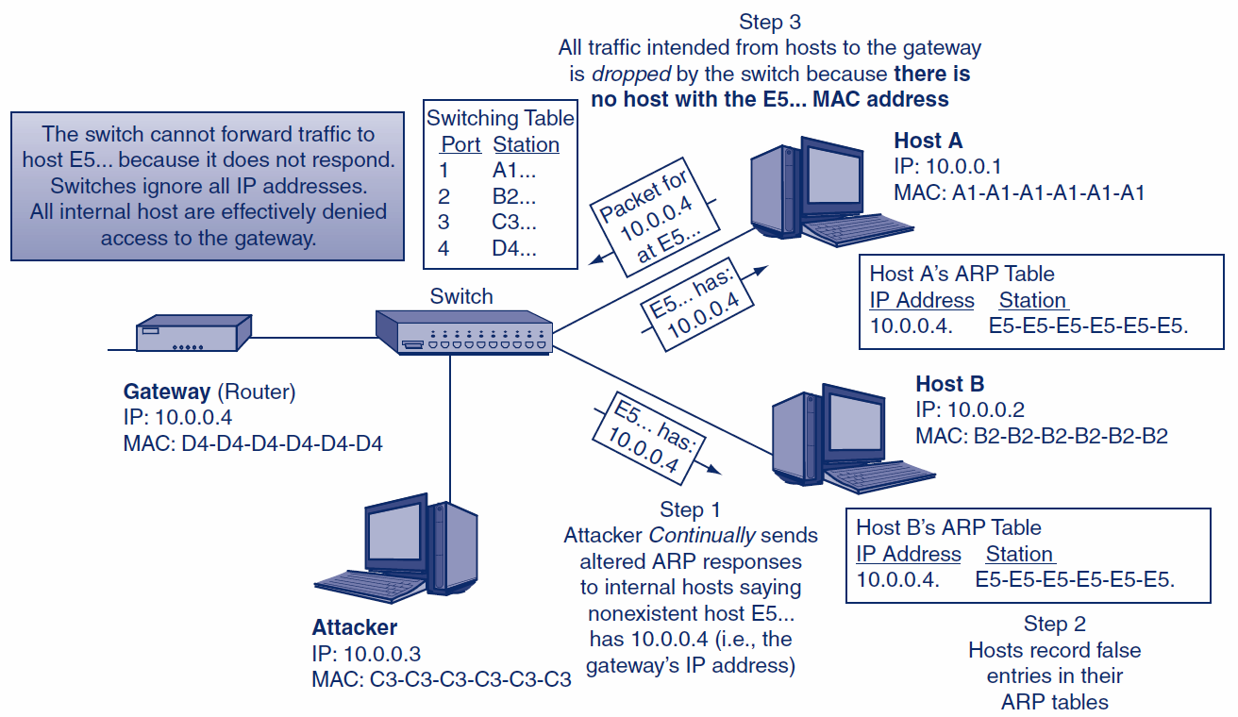
4.3: ARP DoS Attack

Slide 36
4.3: ARP Poisoning
Preventing ARP Poisoning
Static ARP tables are manually set
Most organizations are too large, change too quickly, and lack the experience to effectively manage static IP and ARP tables
Limit Local Access
Foreign hosts must be kept off the LAN

Slide 37
4.3: SLAAC Attack
Stateless Address Auto Configuration (SLAAC) attack
An attack on the functionality and confidentiality of a network
This attack occurs when a rogue IPv6 router is introduced to an IPv4 network
All traffic is automatically rerouted through the IPv6 router, creating the potential for a MITM attack

Slide 38
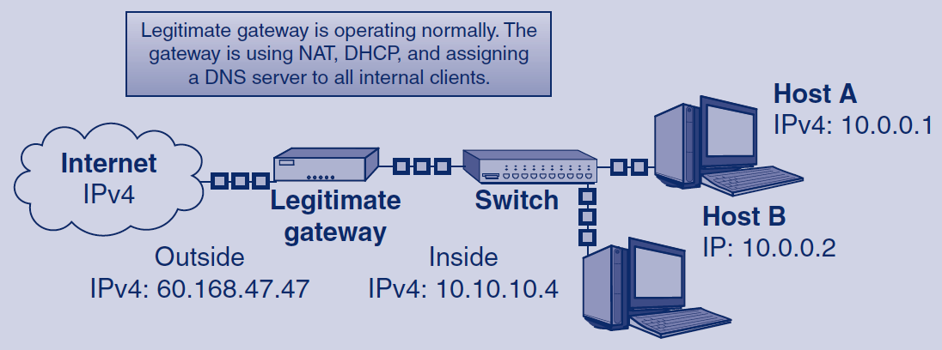
4.3: Normal IPv4 LAN

Slide 39
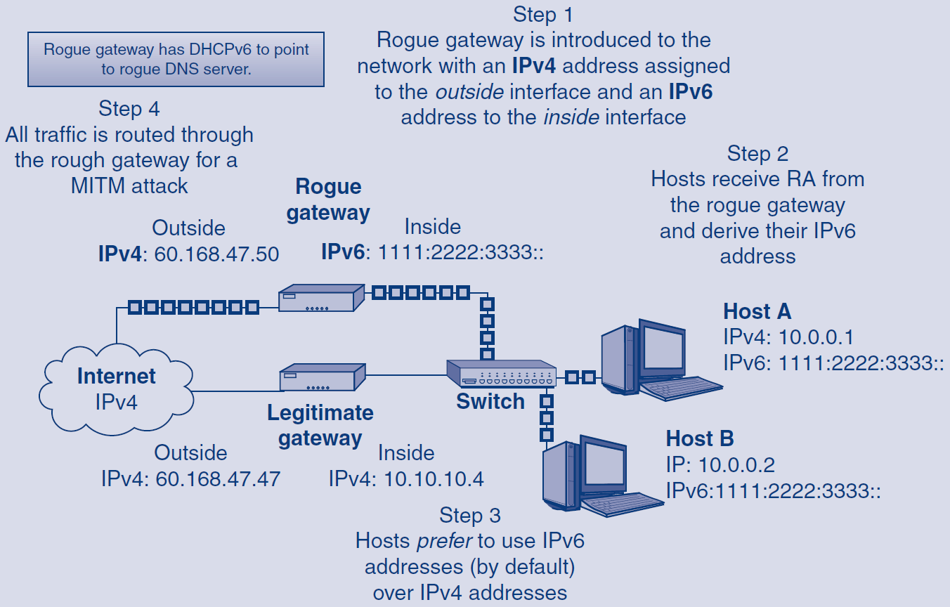
4.3: SLAAC Attack

Slide 40
What’s Next?
4.1 Introduction
4.2 Denial-of-Service (DoS) Attacks
4.3 ARP Poisoning
4.4 Access Control for Networks
4.5 Ethernet Security
4.6 Wireless Security

Slide 41
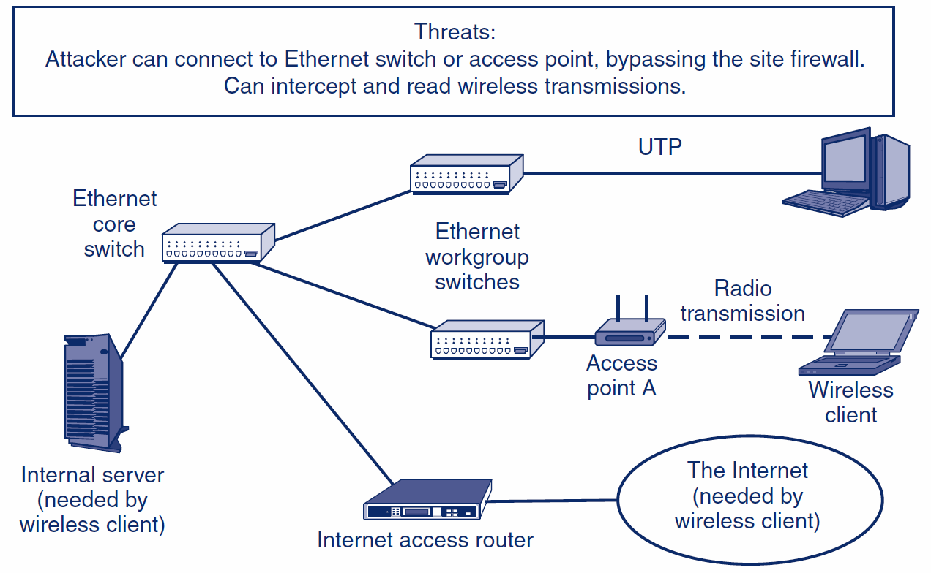
4.4: Corporate LAN

Slide 42
What’s Next?
4.1 Introduction
4.2 Denial-of-Service (DoS) Attacks
4.3 ARP Poisoning
4.4 Access Control for Networks
4.5 Ethernet Security
4.6 Wireless Security

Slide 43
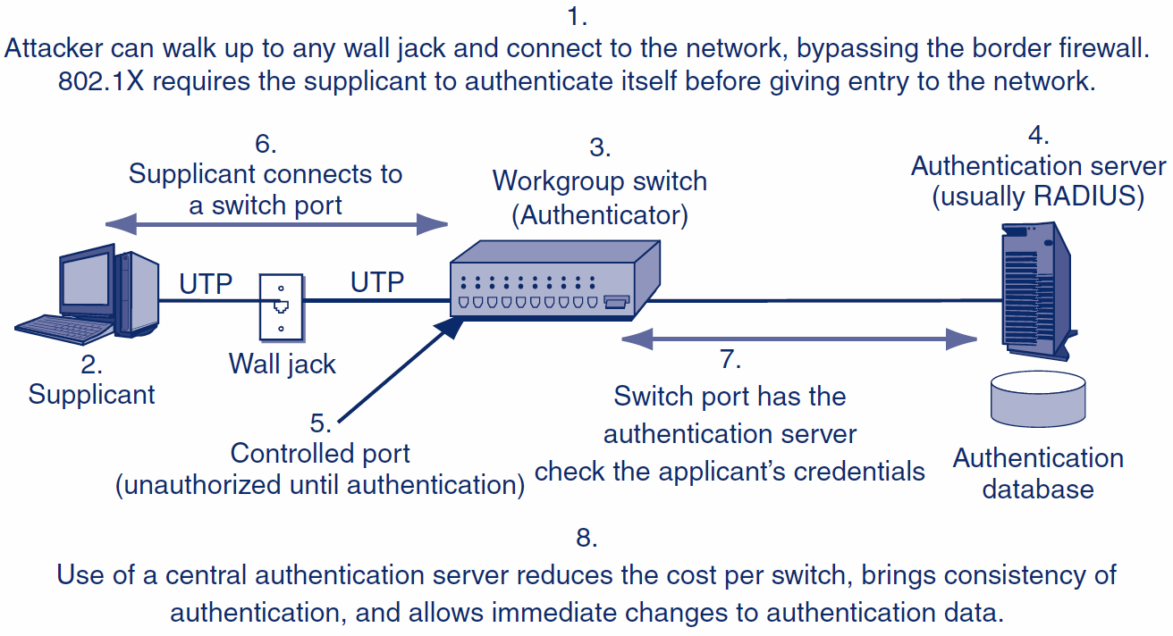
4.5: Ethernet and 802.1X

Slide 44
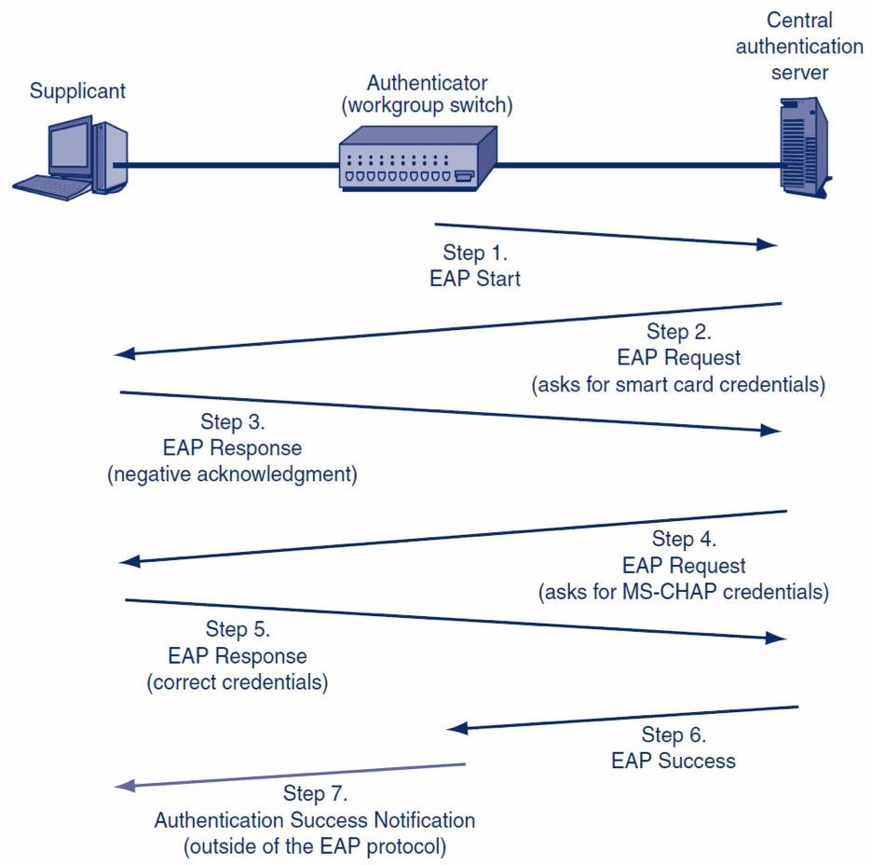
4.5: Extensible Authentication Protocol (EAP)

Slide 45
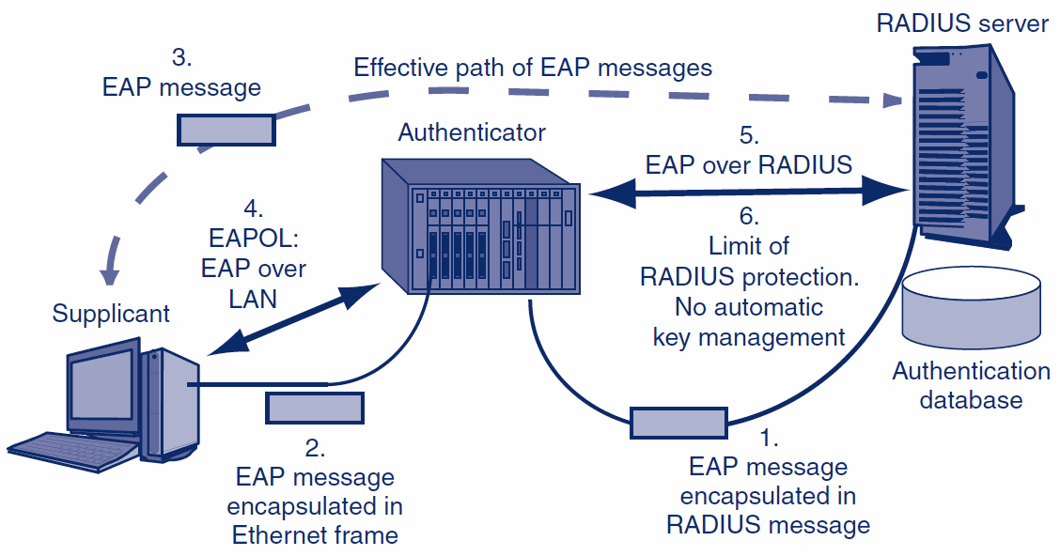
4.5: EAPOL and EAP over RADIUS

Slide 46
4.5: RADIUS and EAP
RADIUS Functionality
Authentication | Authorizations | Auditing
Uses EAP | Uses RADIUS authorization functionality | Uses RADIUS auditing functionality

Slide 47
What’s Next?
4.1 Introduction
4.2 Denial-of-Service (DoS) Attacks
4.3 ARP Poisoning
4.4 Access Control for Networks
4.5 Ethernet Security
4.6 Wireless Security

Slide 48
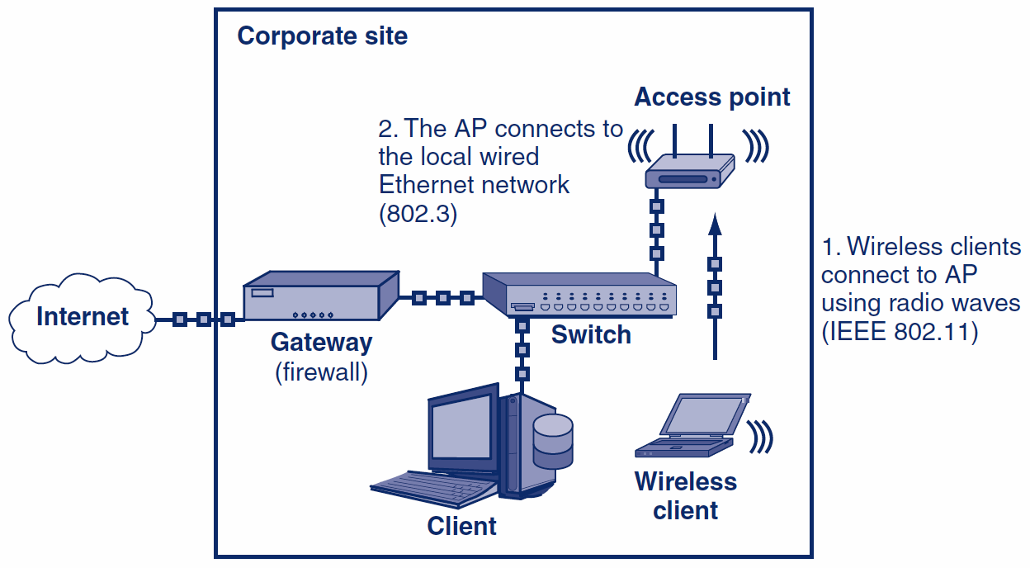
4.6: Wireless Network Access

Slide 49
4.6: Unauthorized Network Access
Open networks can be legally accessed by anyone
Found in public places like cafés, coffee shops, universities, etc.
Private networks that do not allow access unless specifically authorized
Secured networks have security protocols enabled
Users are authenticated and wireless traffic is encrypted

Slide 50
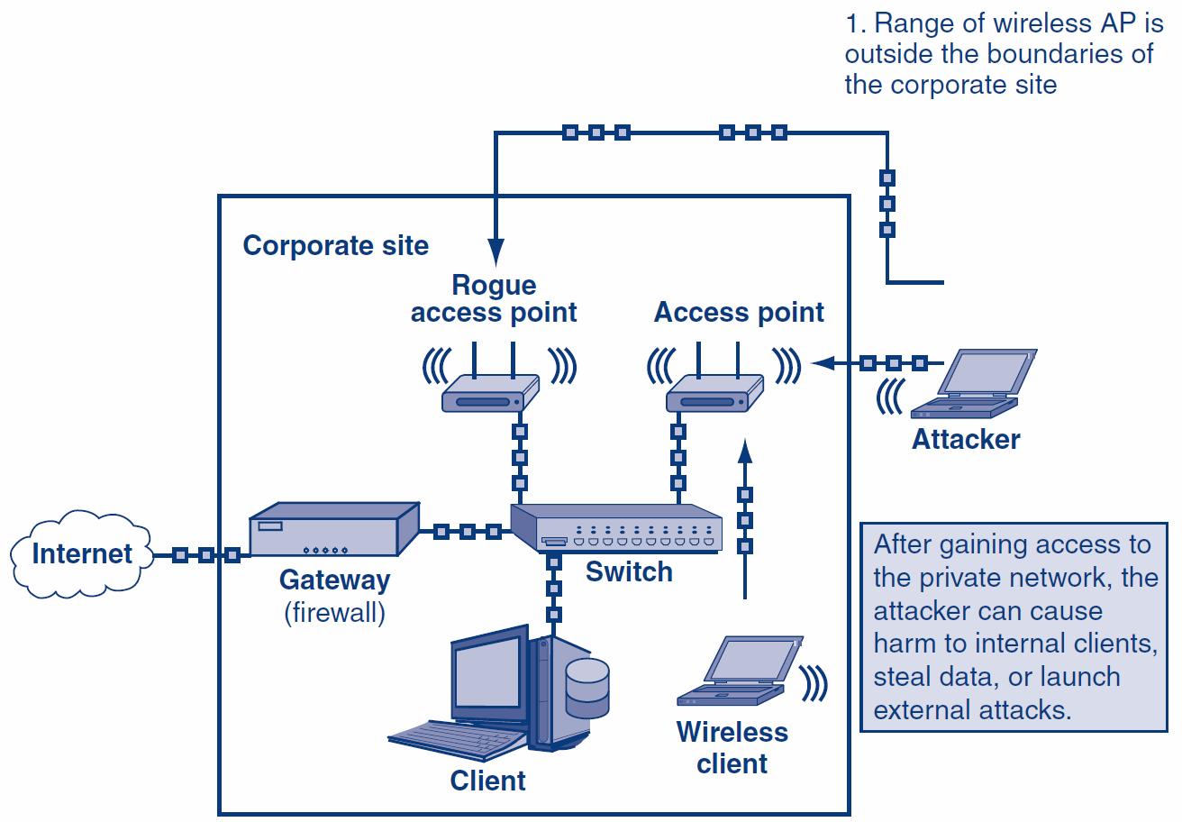
4.6: Unauthorized Wireless Access

Slide 51
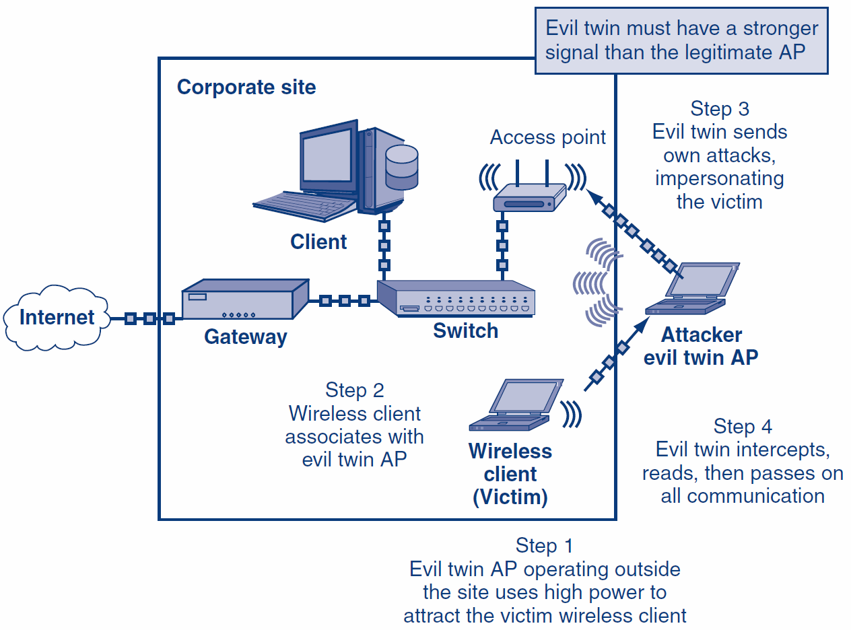
4.6: Evil Twin Access Point

Slide 52
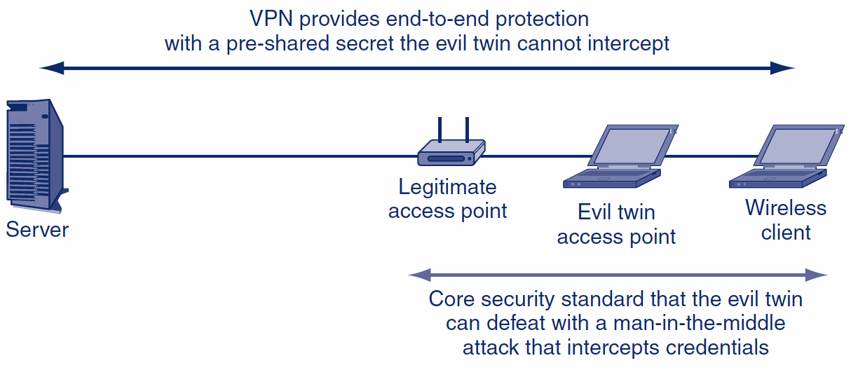
4.6: VPN Protection Against Evil Twin APs

Slide 53
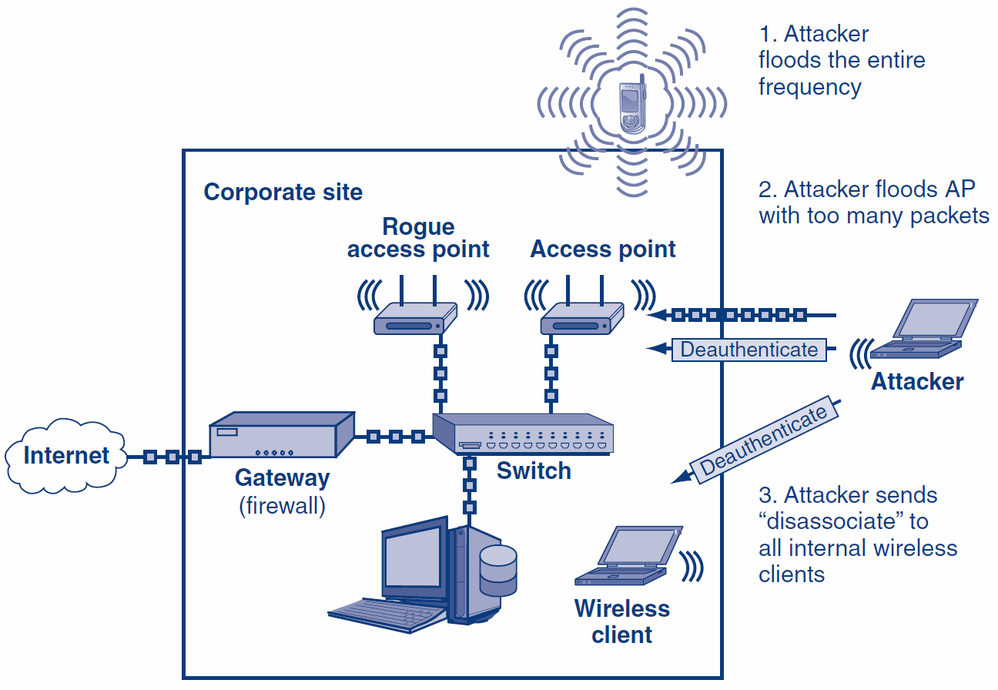
4.6: Wireless DoS − Disassociation & Jamming

Slide 54
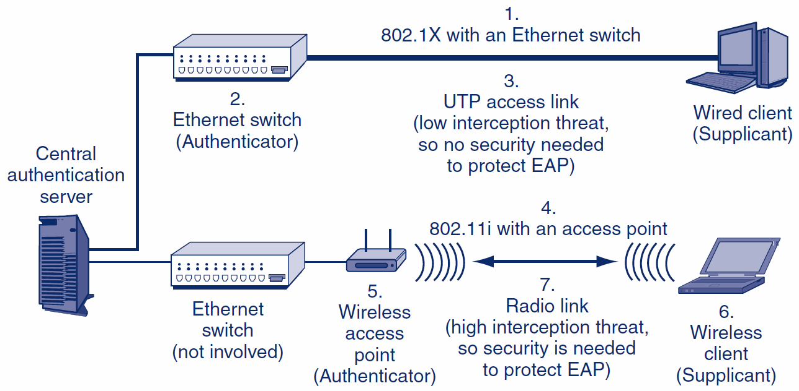
4.6: 802.11i or WPA Wireless LAN Access Control in 802.1X Mode

Slide 55
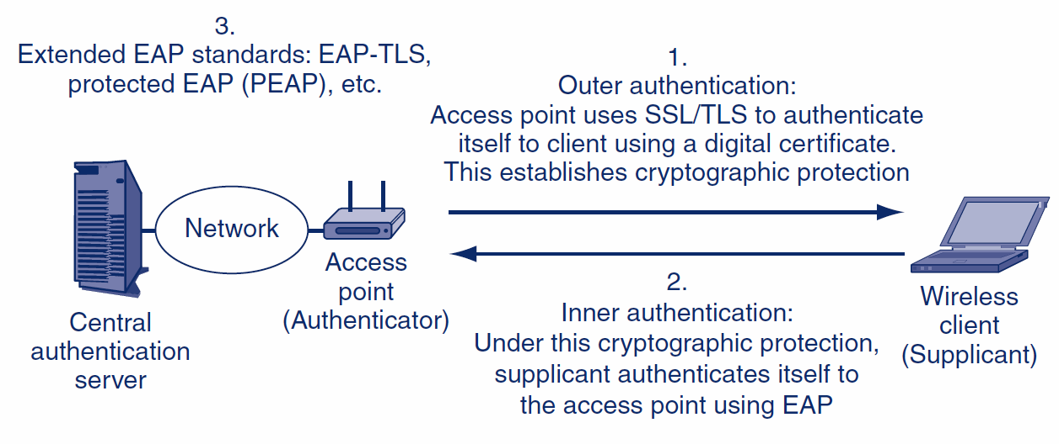
4.6: Extended EAP Protocols

Slide 56
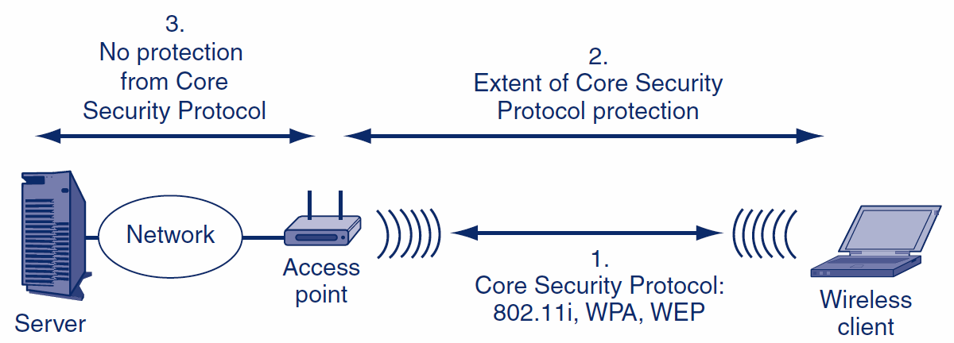
4.6: 802.11 Core Security Protocol

Slide 57
4.6: Wired Equivalent Privacy (WEP)
Origin of WEP
Original core security standard 802.11, created in 1997
Uses a Shared Key
Each station using the access point uses the same (shared) key
The key is supposed to be secret, so knowing it “authenticates” the user
All encryption uses this key

Slide 58
4.6: Wired Equivalent Privacy (WEP)
Problem with Shared Keys
If the shared key is learned, an attacker near an access point can read all traffic
Shared keys should be changed frequently
WEP had no way to do automatic rekeying
Manual rekeying is expensive if there are many users
Manual rekeying is operationally next to impossible if many or all stations use the same shared key, because of the work involved in rekeying many or all corporate clients

Slide 59
4.6: Wired Equivalent Privacy (WEP)
Problem with Shared Keys
Because “everybody knows” the key, employees often give it out to strangers
If a dangerous employee is fired, the necessary rekeying may be impossible or close to it

Slide 60
4.6: Wired Equivalent Privacy (WEP)
RC4 Initialization Vectors (IV)
WEP uses RC4 for fast and therefore cheap encryption
If two frames encrypted with the same RC4 key are compared, the attacker can learn the key
To solve this, WEP encrypts with a per-frame key, which is the shared WEP key plus an initialization vector (IV)
However, many frames “leak” a few bits of the key
With high traffic, an attacker using readily available software can crack a shared key in two or three minutes
(WPA uses RC4 but with a 48-bit IV that makes key bit leakage negligible)

Slide 61
4.6: Wired Equivalent Privacy (WEP)
Conclusion
Corporations should never use WEP for security

Slide 62
4.6: Wi-Fi Protected Access (WPA)
WPA
WPA extends the security of RC4 primarily by increasing the IV from 24 bits to 48 bits
This extension vastly reduces leakage and so makes RC4 much harder to crack
WPA2 (802.11i)
802.11 Working Group completed the 802.11i standard (WPA2) in 2002
Uses stronger security methods

Slide 63
4.6: 802.11
Cryptographic Characteristic | WEP | WPA | 802.11i (WPA2)
Cipher for Confidentiality | RC4 with a flawed implementation | RC4 with 48-bit initialization vector (IV) | AES with 128-bit keys
Automatic Rekeying | None | Temporal Key Integrity Protocol (TKIP), which has been partially cracked | AES-CCMP Mode
Overall Cryptographic Strength | Negligible | Weaker, but no complete crack to date | Extremely strong

Slide 64
4.6: 802.11
Cryptographic Characteristic | WEP | WPA | 802.11i (WPA2)
Operates in 802.1X (Enterprise) Mode? | No | Yes | Yes
Operates in Pre-Shared Key (Personal) Mode? | No | Yes | Yes

Slide 65
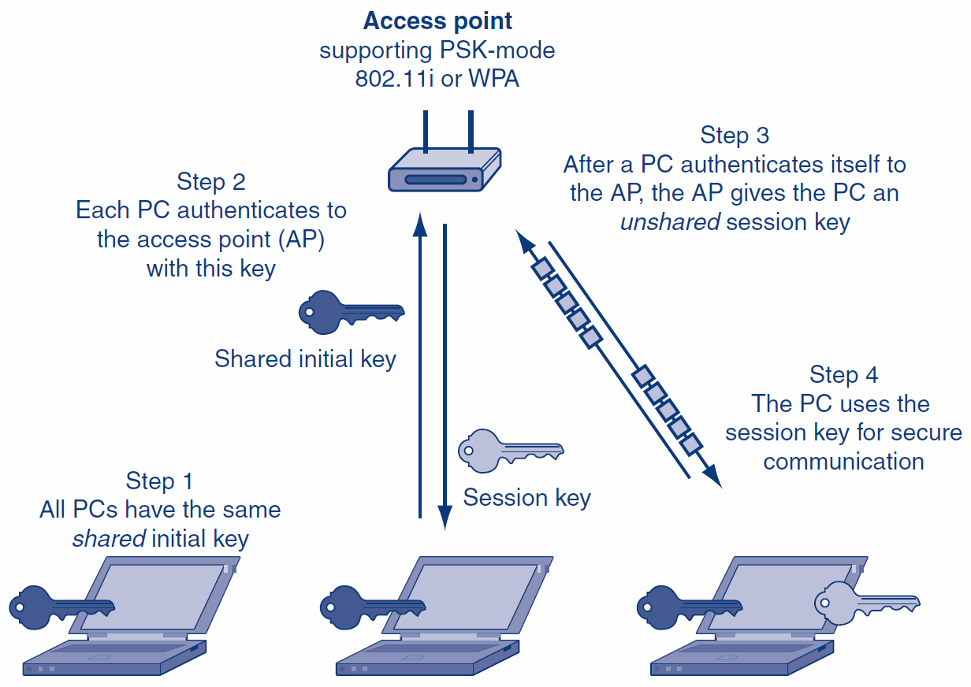
4.6: Pre-Shared Key (PSK)/Personal Mode for 802.11i and EPA

Slide 66
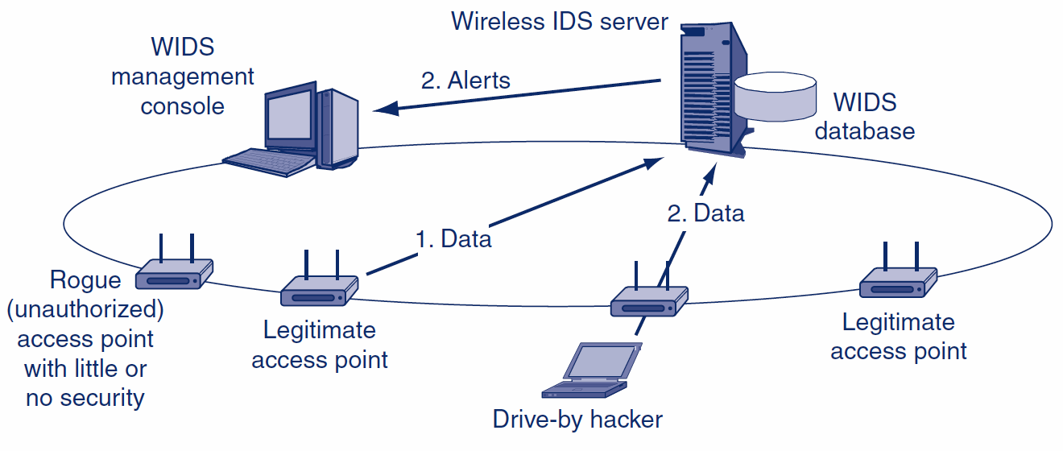
4.6: Centralized Wireless Intrusion Detection System

Slide 67
4.6: False 802.11 Security
Spread Spectrum Operation and Security
Signal is spread over a wide range of frequencies
NOT done for security, as in military spread spectrum transmission

Slide 68
4.6: False 802.11 Security
Turning Off SSID Broadcasting
Service set identifier (SSID) is an identifier for an access point
Users must know the SSID to use the access point
Drive-by hacker needs to know the SSID to break in
Access points frequently broadcast their SSIDs

Slide 69
4.6: False 802.11 Security
Turning off SSID Broadcasting
Some writers favor turning off of this broadcasting
Turning off SSID broadcasting can make access more difficult for ordinary users
Will not deter the attacker because he or she can read the SSID.
Transmitted in the clear in each transmitted frame

Slide 70
4.6: False 802.11 Security
MAC Access Control Lists
Access points can be configured with MAC access control lists
Only permit access by stations with NICs having MAC addresses on the list
However, MAC addresses are sent in the clear in frames, so attackers can learn them
Attacker can then spoof one of these addresses

Slide 71
4.6: False 802.11 Security
Perspective
These “false” methods, however, may be sufficient to keep out nosy neighbors
Drive-by hackers hit even residential users
Simply applying WPA or 802.11i provides much stronger security and is easier to do

Slide 72
The End

Slide 73

All rights reserved. No part of this publication may be reproduced, stored in a retrieval system, or transmitted, in any form or by any means, electronic, mechanical, photocopying, recording, or otherwise, without the prior written permission of the publisher. Printed in the United States of America.
Copyright © 2015 Pearson Education, Inc.

